Slide 1
Building Smarter Manufacturing With The Internet of Things (IoT)
(by Lopez Research LLC )

Slide 2
Contents
Manufacturing: IOT and the Next Industrial Revolution .
Where’s The Value In IoT For Manufacturing?
How to Get Started: Laying The Foundation For IoT in Manufacturing

Slide 3
Manufacturing: IOT and the Next Industrial Revolution
According to a December 2013 survey by the American Society for Quality (ASQ), only 13 percent of the manufacturers surveyed said they use smart manufacturing within their organization.
Organizations that claim to have implemented smart manufacturing, 82 percent say they have experienced increased efficiency, 49 percent experienced fewer product defects and 45 percent experienced increased customer satisfaction.

Slide 4
The development and adoption of the Internet of Things (IoT) is a critical element of smarter manufacturing.
Though manufacturing companies have been implementing sensors and computerized automation for decades, the sensors, Programmable Logic Controllers (PLC) and PC-based controllers and management systems are largely disconnected from IT and operational systems.
While the transition to more open network architectures and data sharing of IoT poses challenges in manufacturing and industrial markets, the combination of IoT, Big Data, and M2M optimization will bring profound opportunities.

Slide 5
As costs of industrial standard “smart” sensors with IP communications and embedded controls falls, these solutions will be implemented across the whole range of manufacturing equipment and in new areas that have not seen heavy investment in automation, such as Balance of Plant4 (BoP) equipment and supply chain logistics.
IoT will benefit manufacturing companies by collecting data from these sensors and communicating that data to factory floor workers, plant managers, software systems and many aspects of the supply chain.

Slide 6
Where’s The Value In IoT For Manufacturing?
Bosch, a German manufacturer of consumer and industrial products, refers to the next wave of manufacturing with IoT-enabled systems as Industry 4.0.
Stefan Ferber, Director for business development of the IoT at Bosch Software Innovations, said “Industry 1.0 was the invention of mechanical help, Industry 2.0 was mass production, pioneered by Henry Ford, Industry 3.0 brought electronics and control systems to the shop floor, and Industry 4.0 is peer-to-peer communication between products, systems and machines.”

Slide 7
People: IoT in manufacturing will improve business by connecting people to the right information, over the right device at the point of need and cross company boundaries to include suppliers, maintenance partners, and distribution chains.
Process: As IoT becomes more pervasive, manufacturers will enable faster information flow, faster decisions, and greater market responsiveness by connecting devices into both operational and business software processes.

Slide 8
  For example, GM uses sensor data to decide if it’s too humid to paint an automobile. If the system defines the conditions are unfavorable, the automobile will be routed to another area of the manufacturing process, reducing repainting and maximizing plant uptime.
Data: IoT will connect physical items such as sensors, actuators, video cameras and RFID readers – to the Internet and to each other. Big data processing and analytics, either on-premise or in the cloud, will collect and analyze data from IoT-enabled devices. These solutions will turn data into context that can be used to help people and machines make more relevant and valuable decisions.

Slide 9
What It Means For Your Business? IoT Manufacturing Use Cases
Factory visibility: IoT data and IP networks will connect what’s happening on the factory floor to enterprise-based systems and decision makers.
  For example, GE mobile-enabled SCADA applications allow tablets to display performance data and status updates traditionally available only on PCs.

Slide 10
Automation: Once machinery and systems are connected within the plant, manufacturers can use this information to automate workflows to maintain and optimize production systems without human intervention.
  One example of this is Harley-Davidson’s use of IoT in its York, PA motorcycle plant. The company installed software that keeps a record of how different equipment is performing, such as the speed of fans in the painting booth. The software can automatically adjust the machinery if it detects that a measurement – such as fan speed, temperature, or humidity – has deviated from acceptable ranges

Slide 11
Energy management: Many companies lack cost effective measurement systems and modeling tools and/or performance and management tools to optimize energy use in individual production operations, much less in real-time across multiple operations, facilities, or an entire supply chain.
  For example, HVAC and electricity can create cost savings for manufacturers. Connected energy solutions can provide peak demand charge avoidance and enable economy model operations. Certain IoT-enabled HVAC systems also offer integrated weather data and prediction analysis to help manufacturers understand expenses and plan energy usage.

Slide 12
Proactive maintenance: Manufacturers have widely accepted the concept of preventative and condition-based monitoring but many are still in the process of implementing these programs. Lower cost sensors, wireless connectivity and big data processing tools make it cheaper and easier to collect actual performance data and monitor equipment health.
  For example, If the manufacturer has equipment that’s supposed to operate within a certain temperature range, the company can use sensors to actively monitor when it goes out of range and prevent malfunctions.

Slide 13
Connected Supply Chain: IoT, analytics and IP networks will help manufacturers gain a better understanding of the supply chain information that can be delivered in realtime.
  By connecting the production line and balance of plant equipment to suppliers, all parties can understand interdependencies, the flow of materials, and manufacturing cycle times.
  IoT enabled systems can be configured for location tracking, remote health monitoring of inventory, and reporting of parts and products as they move through the supply chain, among many other things.
  IoT systems can also collect and feed delivery information into an ERP system; providing up-to-date information to accounting functions for billing.

Slide 14
How to Get Started: Laying The Foundation For IoT in Manufacturing
Network: A smart manufacturing environment requires a standardized IP-centric network that will enable all devices within a plant to communicate to both operational and enterprise business systems.
Security: Operations managers need to ensure that safeguards are built into the solution including security procedures such as hardware encryption, physical building security and network security for data in transit.

Slide 15
Software systems: It requires collecting a wide range of data from a variety of sensors. These software systems and models must translate information from the physical world into actionable insight that can be used by humans and machines.
Big data and analytics: While manufacturers have been generating big data for many years, companies have had limited ability to store, analyze and effectively use all the data that was available. New big data processing tools are enabling real-time data stream analysis that can provide dramatic improvements in real time problem solving and cost avoidance.

Slide 16
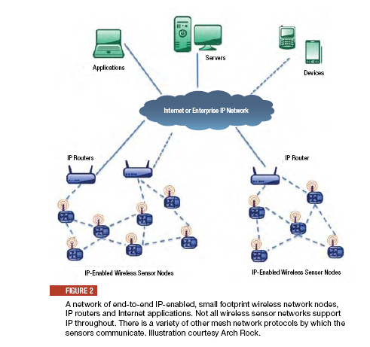
IP-enabled wireless sensor network

