Slide 1
Big Data Why, What, How, …etc
林君維

Slide 2
Industry 4.0

Slide 4
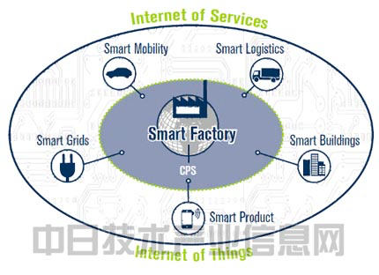

Slide 5
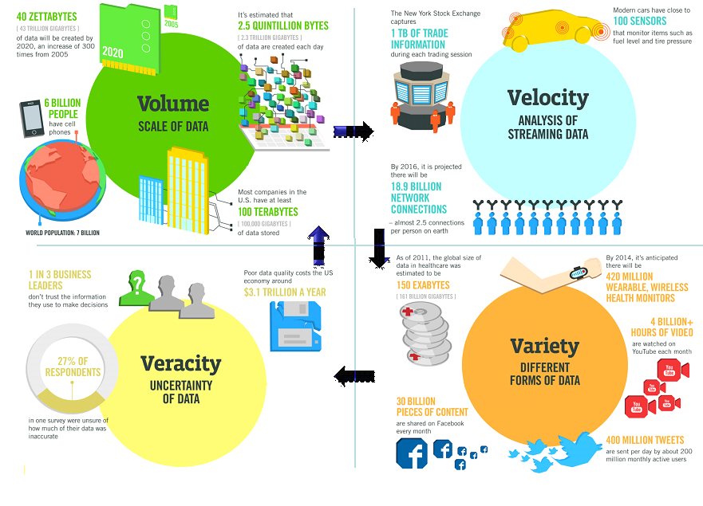

Slide 6
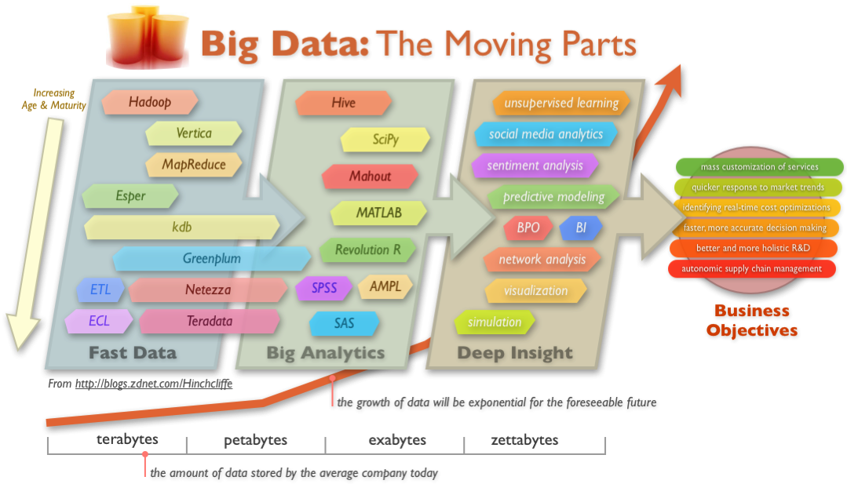

Slide 7
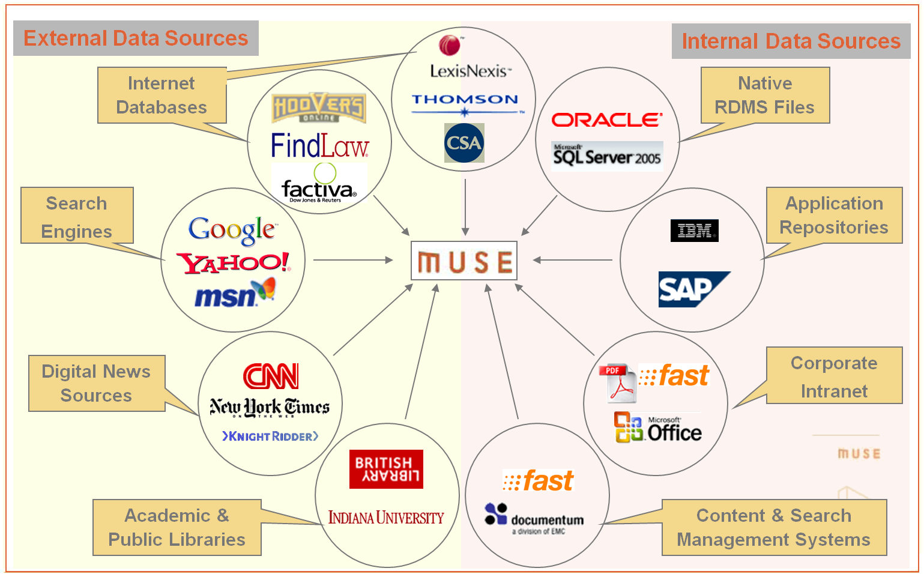

Slide 8
NSF-Big Data Initiatives

